Slide 1
DYLAN’S CONTEMPORARIES
The Kardomah Gang
With original images by Jeff Phillips

Slide 2
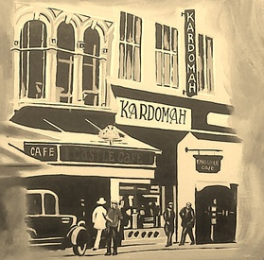

Slide 3
The Kardomah, Castle Street, Swansea... where, in the 1930’s, a group of creative people would get together to chat, exchange ideas.
And dream.
They became known as The Kardomah Gang or The Kardomah Boys...

Slide 4
They consisted of poets, a musician, artists and writers.
They didn’t all meet there at the same time, but it was a corner of Swansea where they knew they could call by and find a like-minded person for a lively conversation.
Who were they?

Slide 5
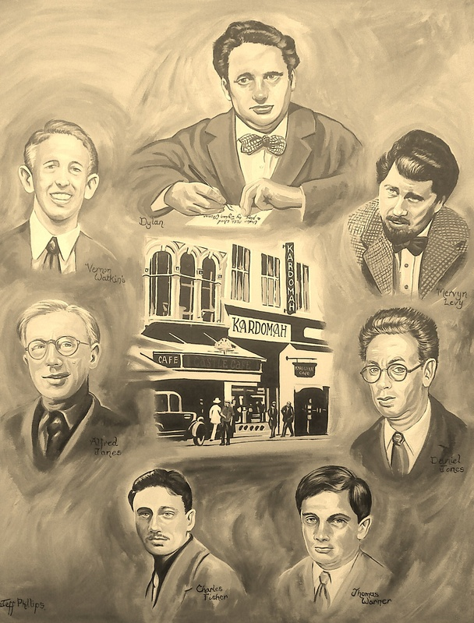

Slide 6
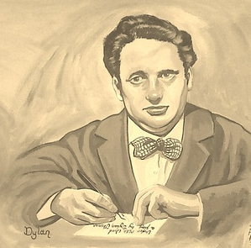
At the centre of this gang of creative artists was the poet Dylan Thomas...

Slide 7
He described the Kardomah gang in his radio broadcast Return Home. He wrote how
‘ Dan Jones was going to compose the most prodigious symphony, Fred Janes paint the most miraculously meticulous picture, Charlie Fisher catch the poshest trout, Vernon Watkins and Young Thomas write the most boiling poems, how they would ring the bells of London and paint it like a tart...’
He described the Kardomah as being ‘razed to the snow’ after the Luftwaffe raids of 1941 which destroyed Swansea in the Three Night Blitz.

Slide 8
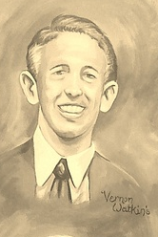
There was the poet Vernon Watkins...
who was being considered for the post of Poet Laureate when he died in 1967 in Seattle
who worked almost his entire life in Lloyds Bank in Swansea, in order to allow time for writing poetry
at whose wedding Dylan Thomas failed to turn up, even though he was supposed to be the best man.
whose poetry was greatly admired by T.S.Eliot and Philip Larkin

Slide 9
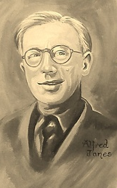
The painter Alfred Janes
lectured at the Swansea College of Art for many years
painted several members of the Kardomah Boys. See his work on
http://www.bbc.co.uk/arts/yourpaintings/artists/alfred-janes-26144

Slide 10
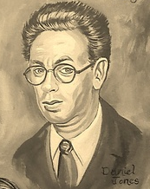
The composer Daniel Jones...
born in Pembroke, moving to Swansea later
who became one of the talented composers of the 20th century. His friend, the poet Charles Fisher said
His genius... has never received the recognition which was its due. He deserves to be regarded as Dylan’s equal in the field of creation, not as an extra, or a spear-bearer or as one to be dismissed lightly as ‘Dylan’s friend’.
He worked as a code-breaker for the government at Bletchley Park during the Second World War.

Slide 11
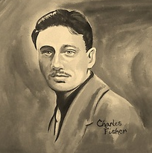
The poet Charles Fisher...
moved to Canada after Dylan Thomas’s death
was the last of the Kardomah Gang to pass away, aged 91 in 2006, travelling in Thailand
worked as a journalist for Reuters then as a reporter for Hansard, for the Canadian government.
was a talented poet
he had a special interest in the Romani gypsies of Granada in Spain
played flamenco guitar

Slide 12
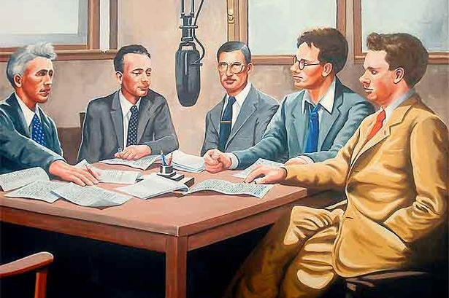
The Castle Street Kardomah was bombed by the Luftwaffe in the air raids of 1941, and relocated to Portland Street, where it still stands and is a very popular Swansea cafe.
This painting is by Jeff Phillips of the Kardomah boys, a copy of a Radio Times cover in 1949.

